Slide 1

Diabetes Prediction Analysis using SQL

Slide 2
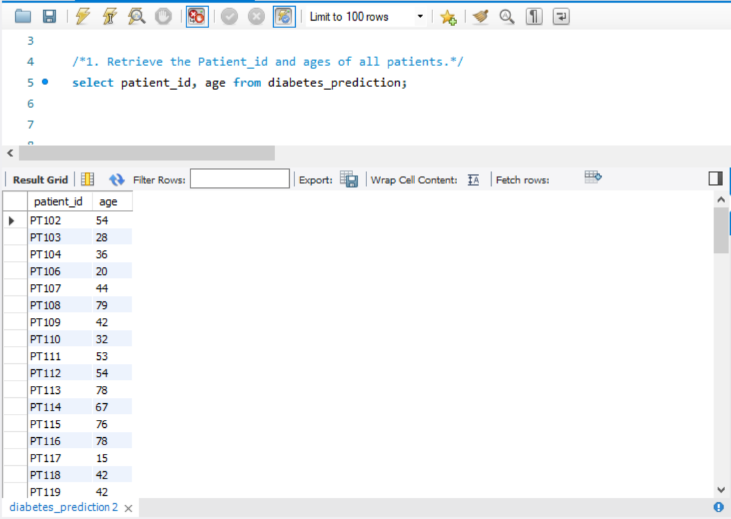
1. Retrieve the Patient_id and ages of all patients.

Slide 3
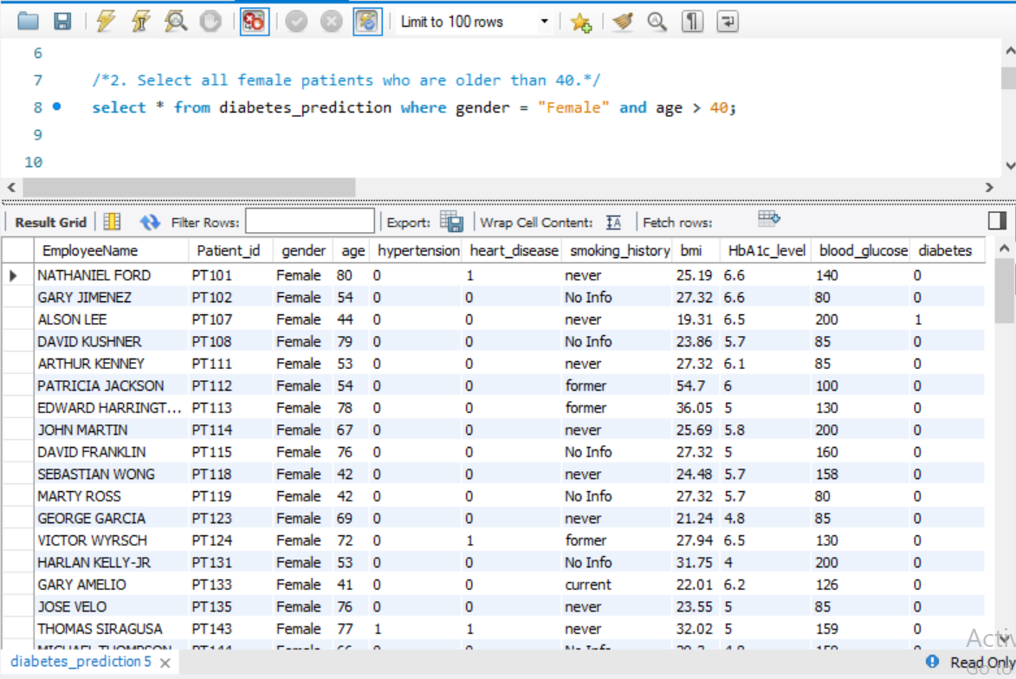
2. Select all female patients who are older than 40.

Slide 4
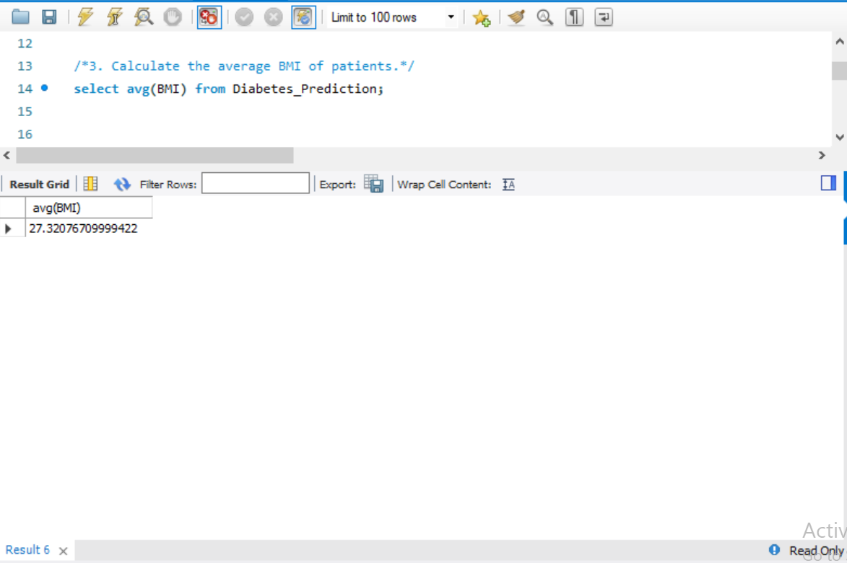
3. Calculate the average BMI of patients.

Slide 5
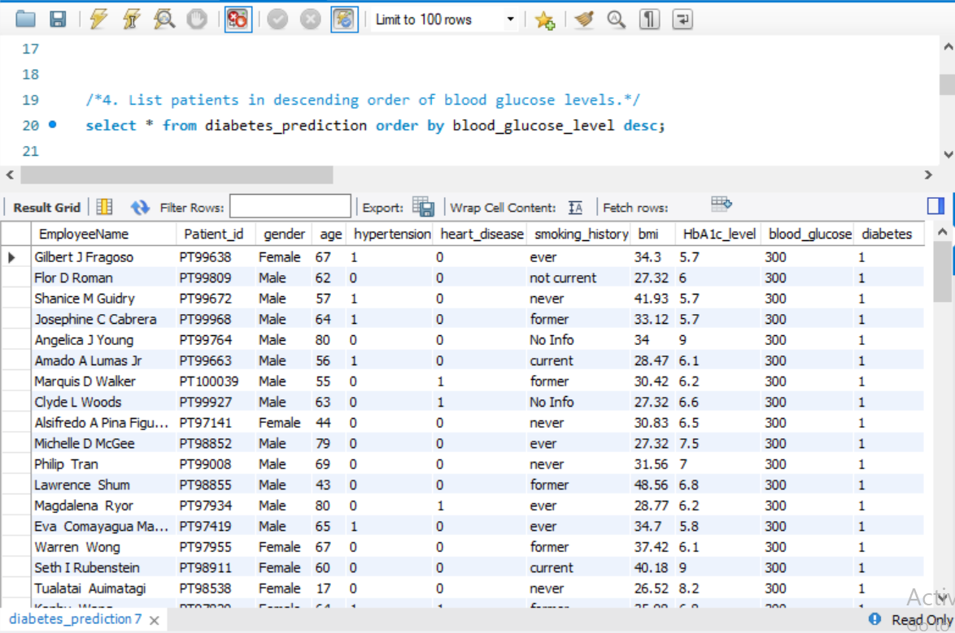
4. List patients in descending order of blood glucose levels.

Slide 6
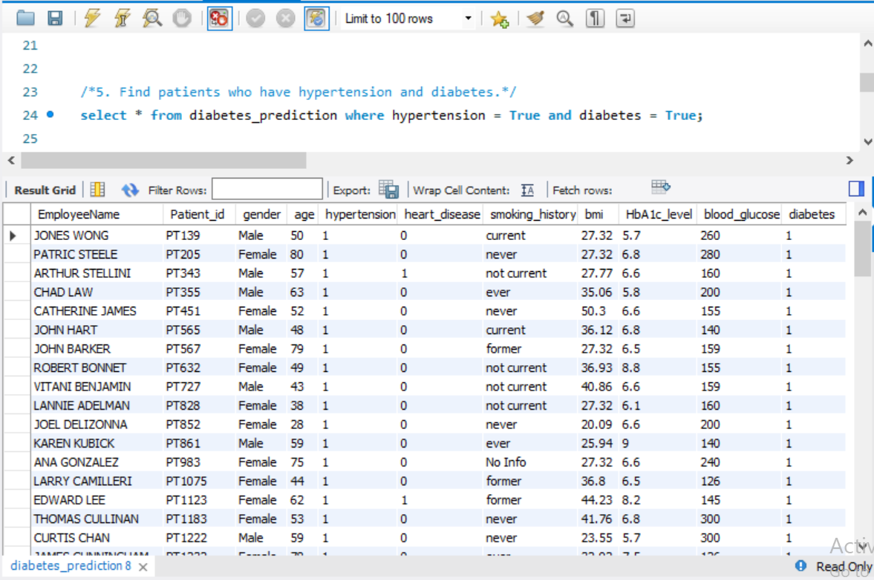
5. Find patients who have hypertension and diabetes.

Slide 7
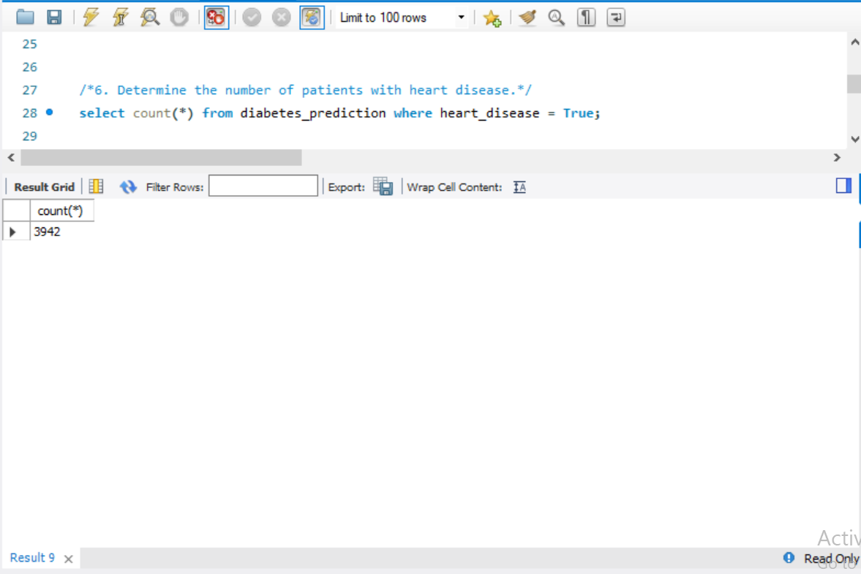
6. Determine the number of patients with heart disease.

Slide 8
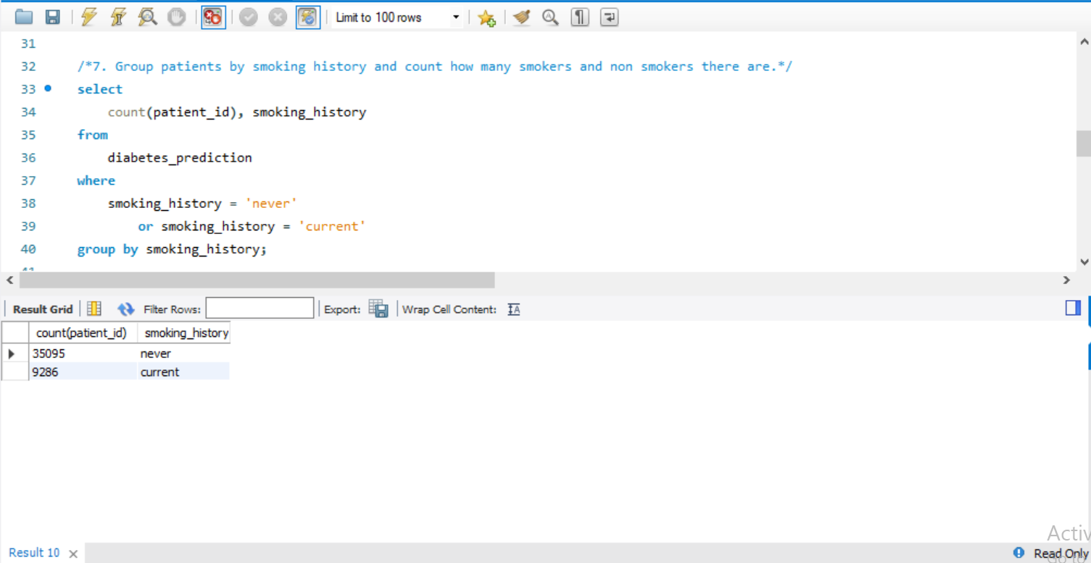
7. Group patients by smoking history and count how many smokers and non smokers there are.

Slide 9
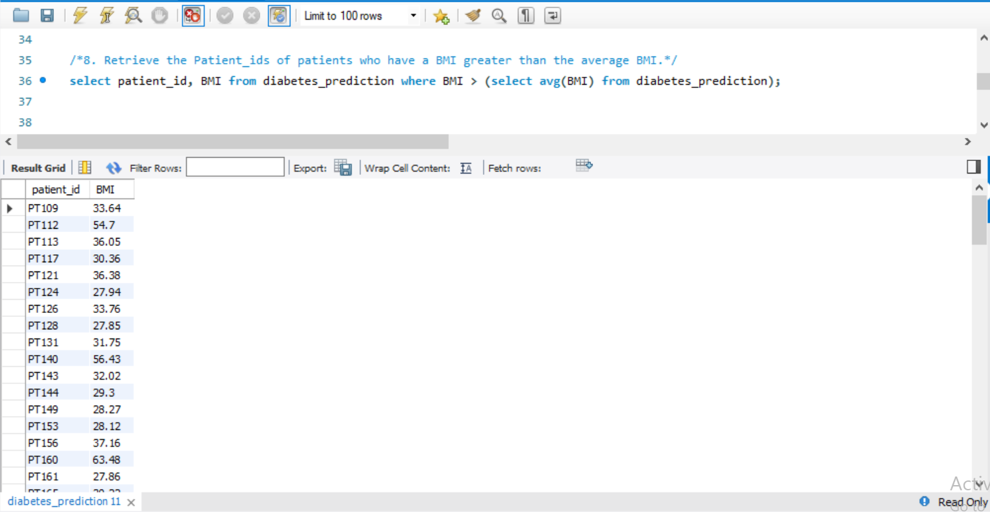
8. Retrieve the Patient_ids of patients who have a BMI greater than the average BMI.

Slide 10
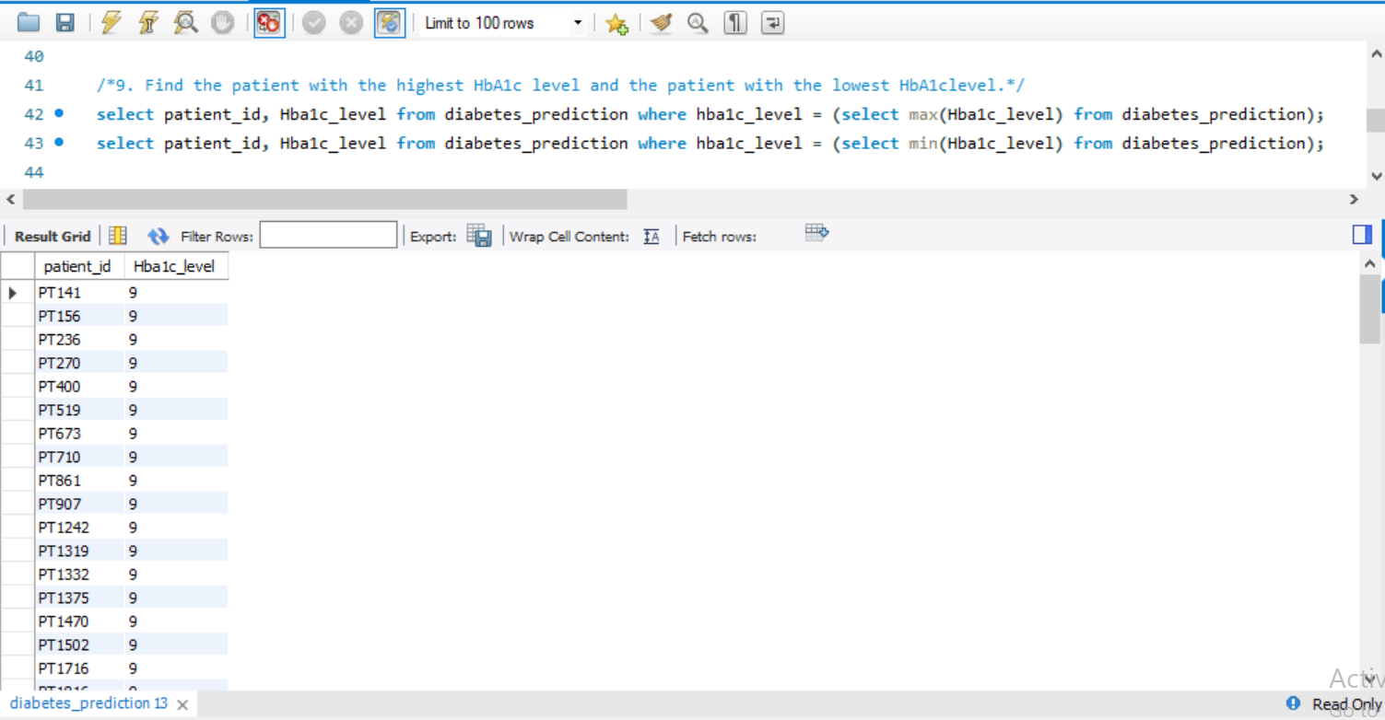
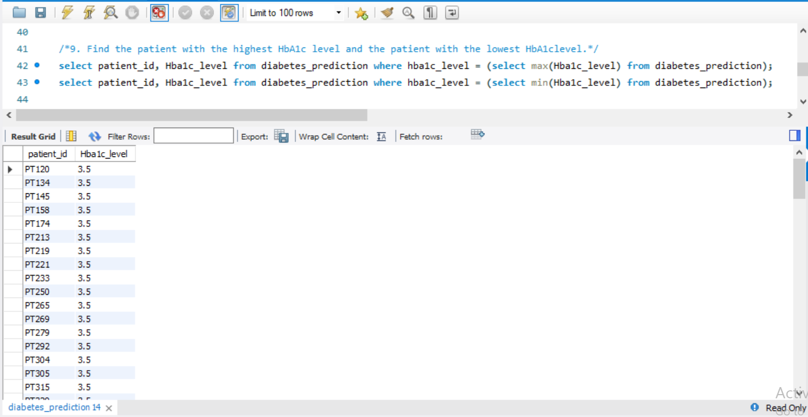
9. Find the patient with the highest HbA1c level and the patient with the lowest HbA1clevel.

Slide 11
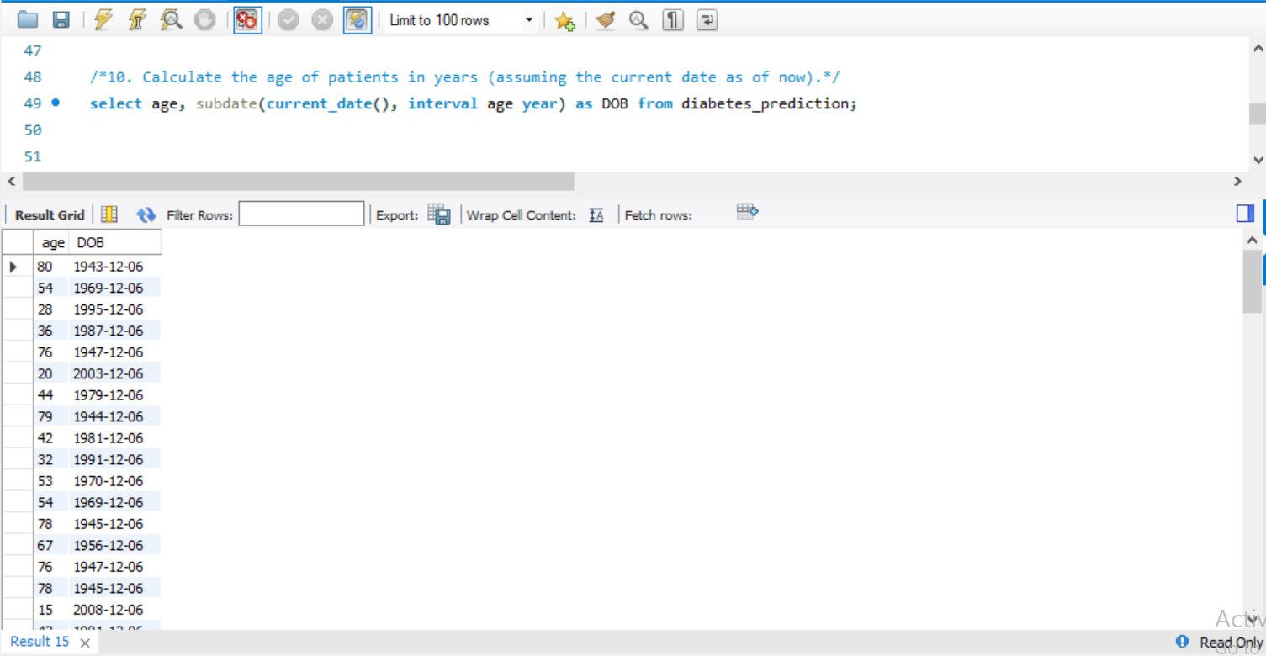
10. Calculate the age of patients in years (assuming the current date as of now).

Slide 12
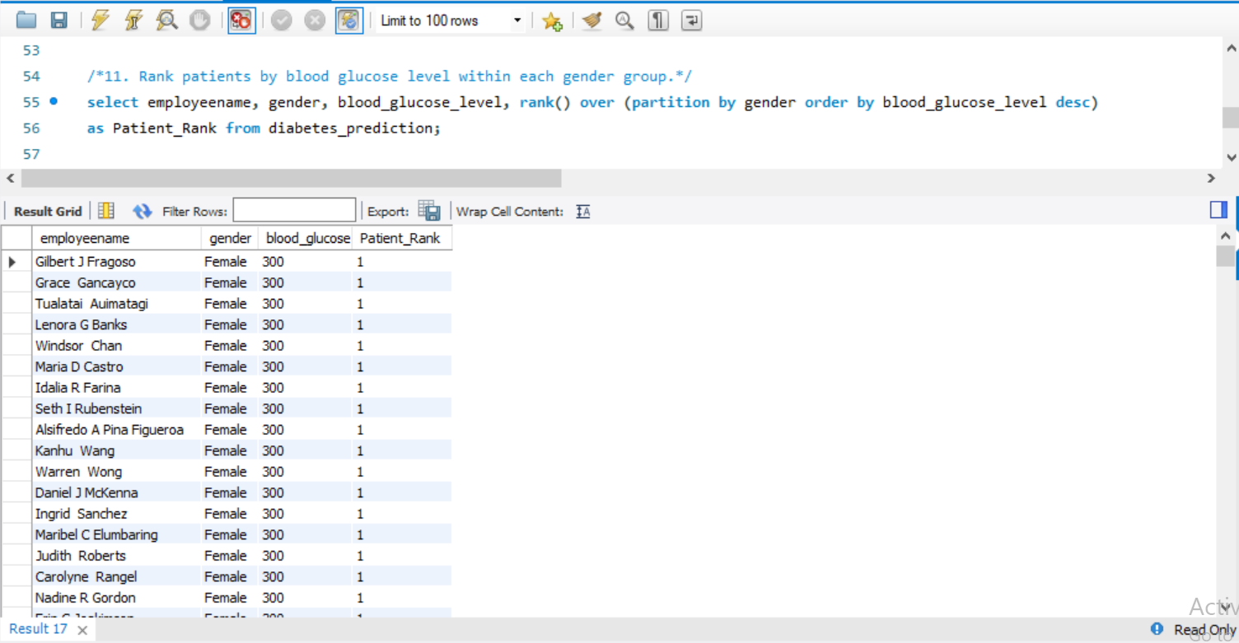
11. Rank patients by blood glucose level within each gender group.

Slide 13
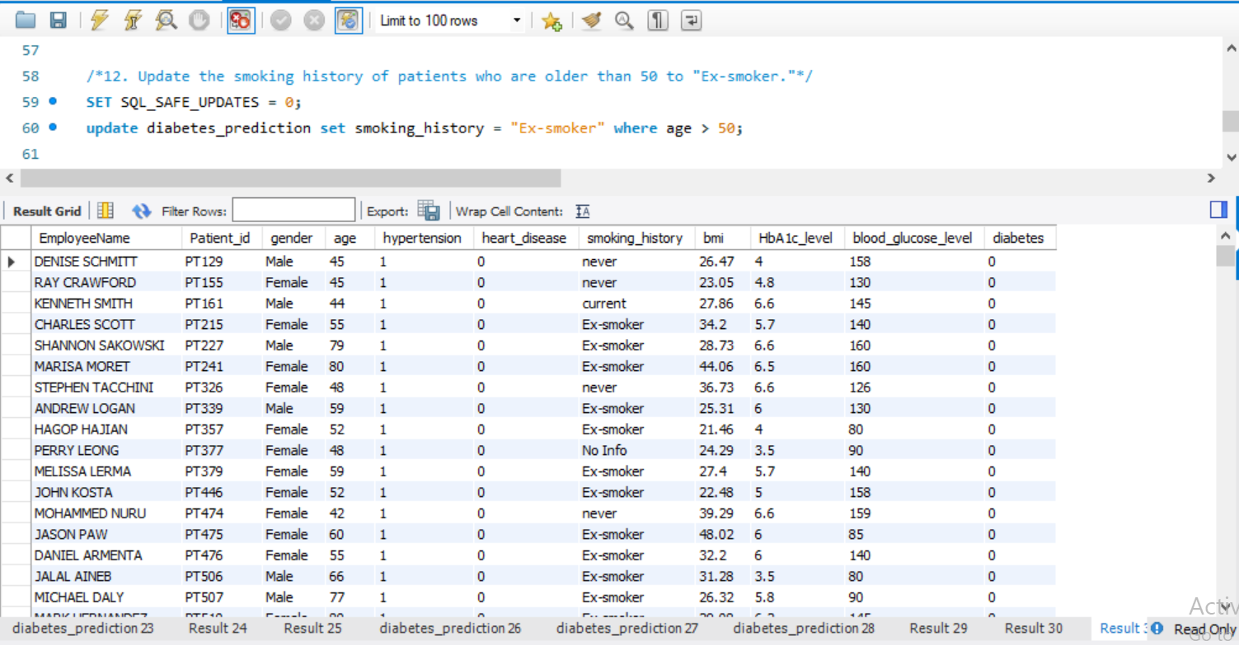
12. Update the smoking history of patients who are older than 50 to "Ex-smoker."

Slide 14
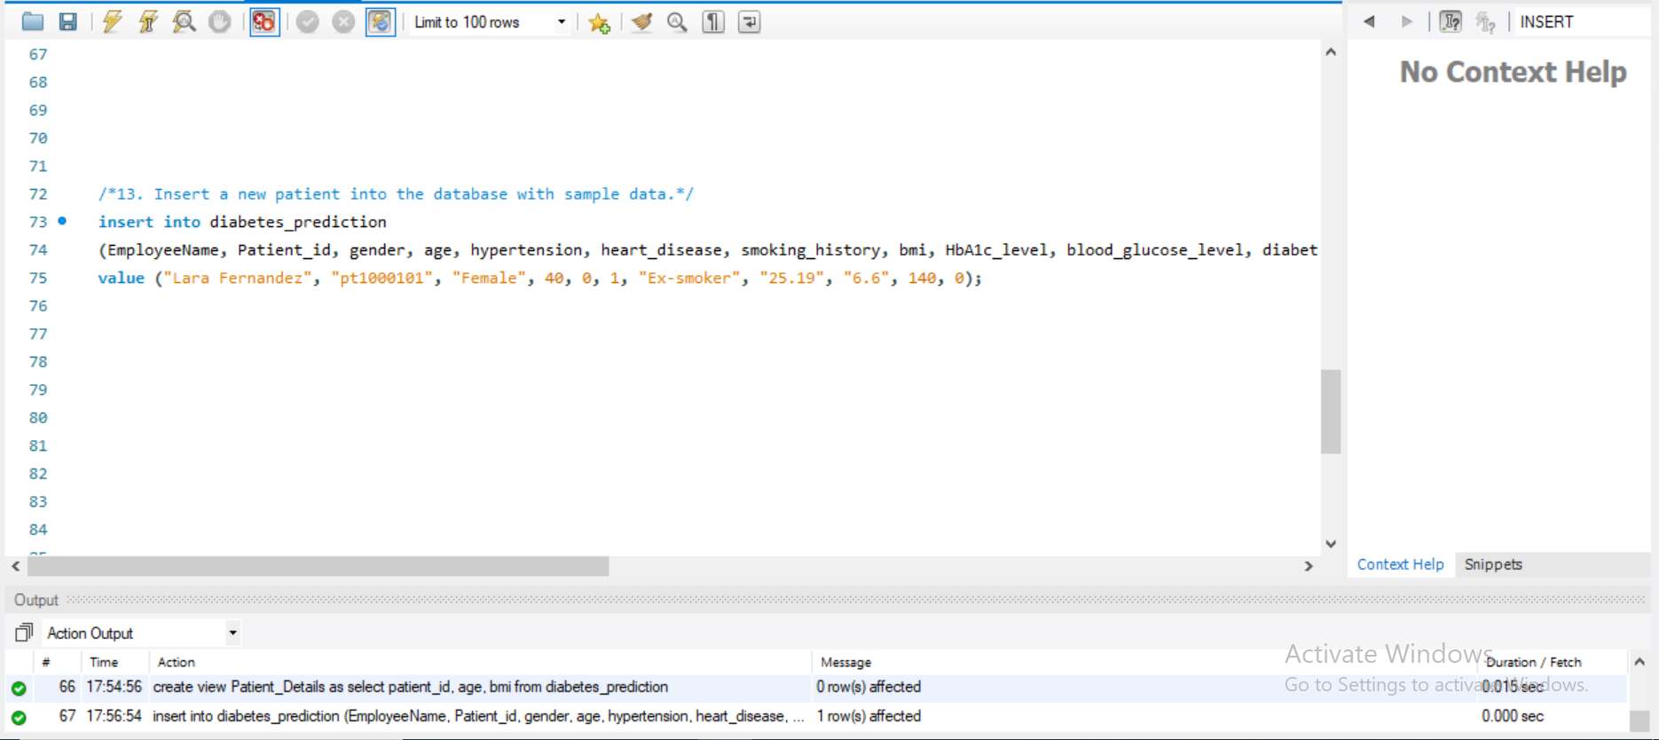
13. Insert a new patient into the database with sample data.

Slide 15
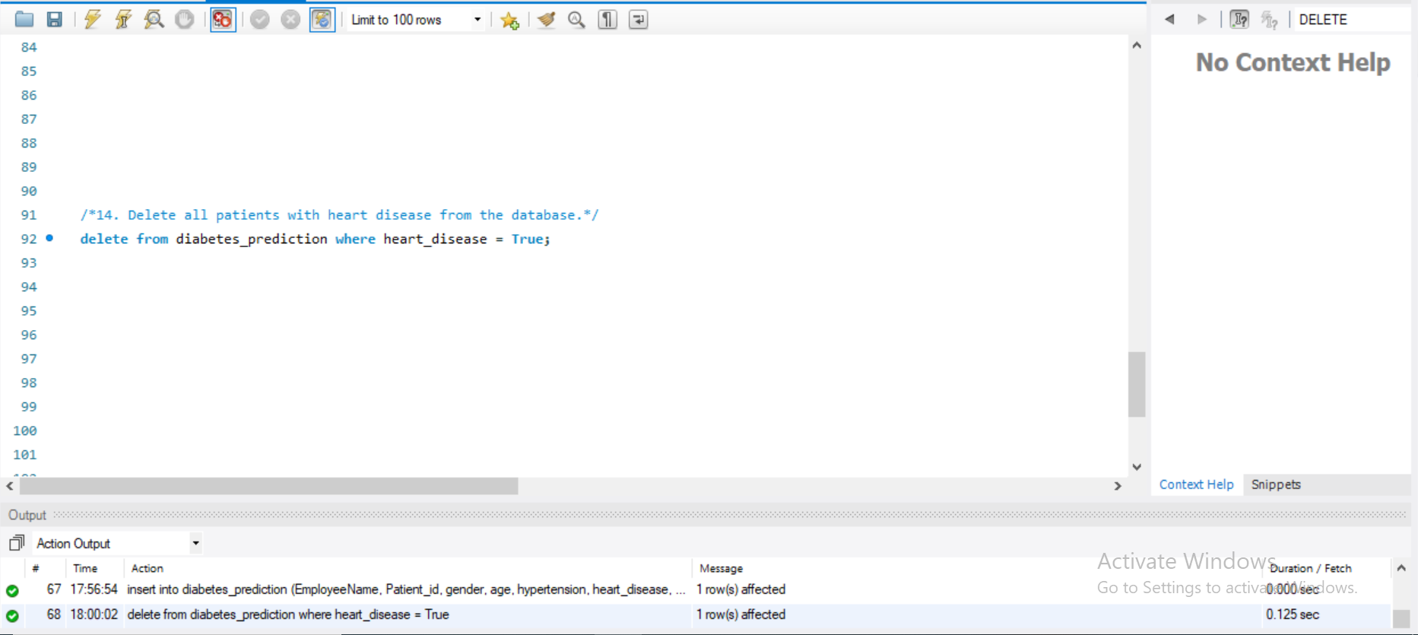
14. Delete all patients with heart disease from the database.

Slide 16
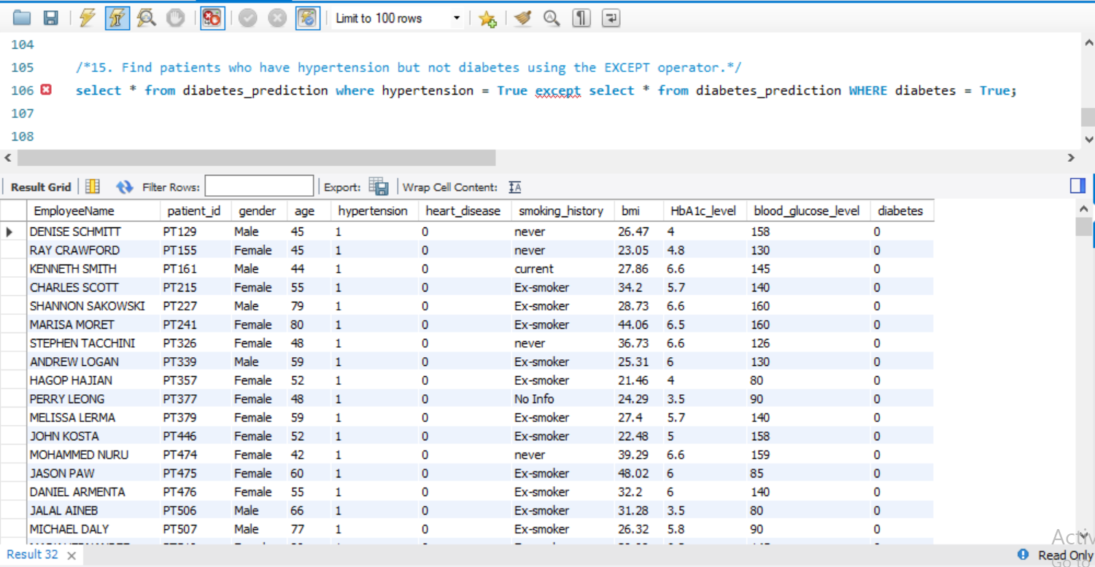
15. Find patients who have hypertension but not diabetes using the EXCEPT operator.

Slide 17
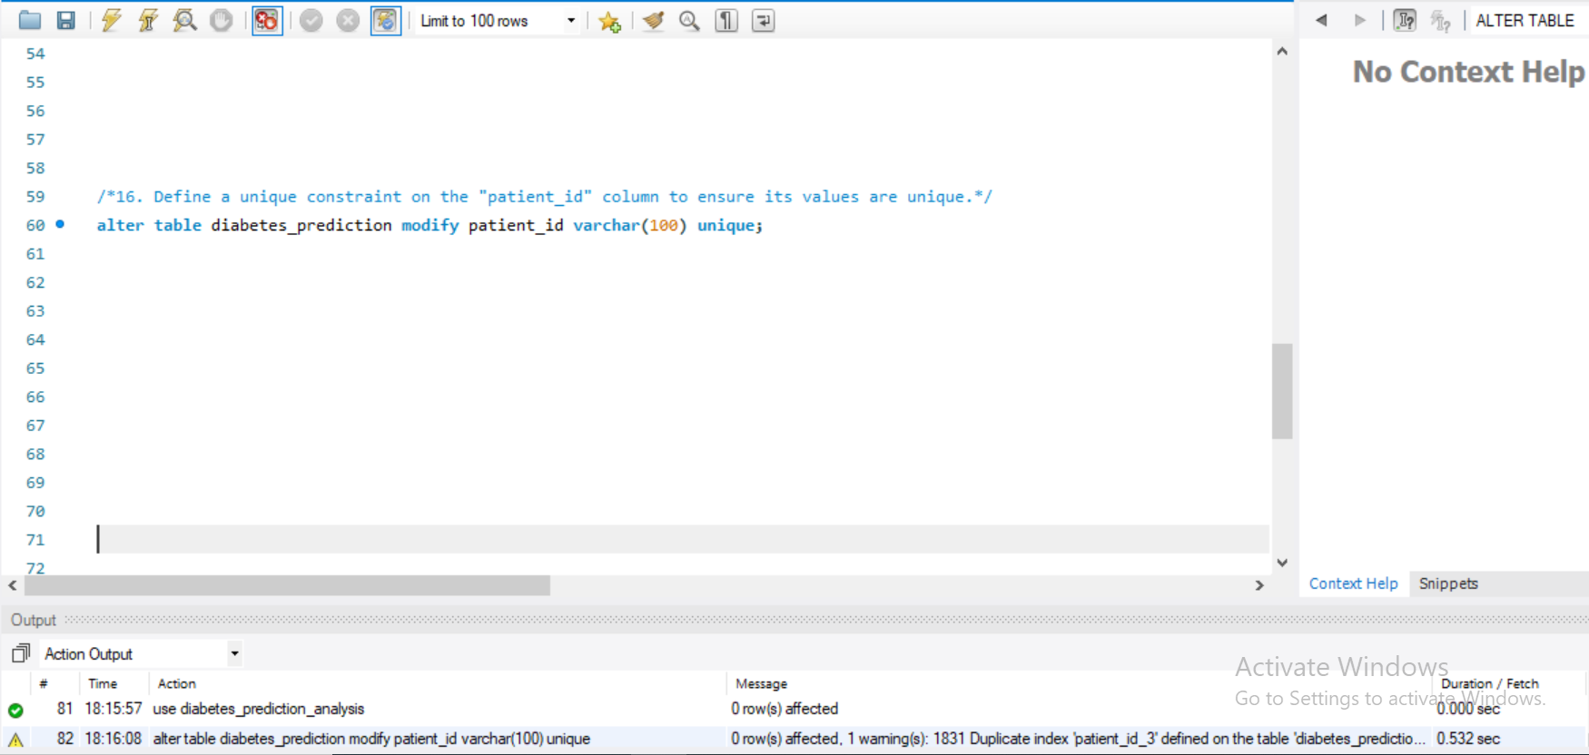
16. Define a unique constraint on the "patient_id" column to ensure its values are unique.

Slide 18
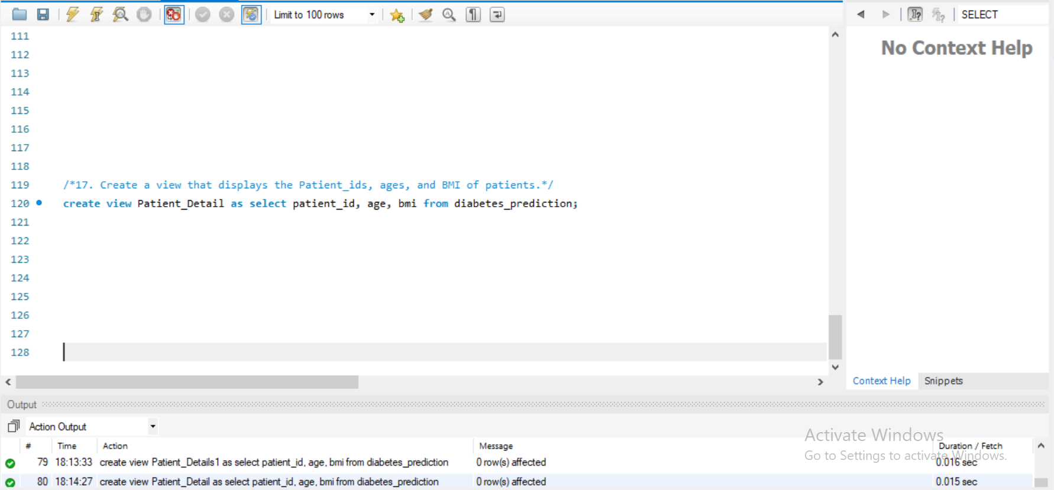
17. Create a view that displays the Patient_ids, ages, and BMI of patients.

Slide 19
18. Suggest improvements in the database schema to reduce data redundancy and improve data integrity.
Normalizating Database - Database normalization involves efficiently arranging data in a database to ensure redundancy elimination. Normalizing data typically includes arranging a database columns and tables to ensure they correctly enforce their dependencies. Normalization involves breaking down a larger table into smaller tables and establishing relationships between them.
Clean unnecessary data from the database - Like organizations may move their data to a new database and keep the same data in the old one. This can lead to data duplication and storage waste. Organizations can avoid this redundancy by promptly deleting the data no longer required.
Master Data - The main benefit of using master data is that in case a data piece changes, the organization, instead of working on the overall data, has only to update that one piece of data.
Design your Database - The relational databases will ensure that you have common fields and allow you to link up tables and match records. This will make it easier for you to figure out repetition and remove it.

Slide 20
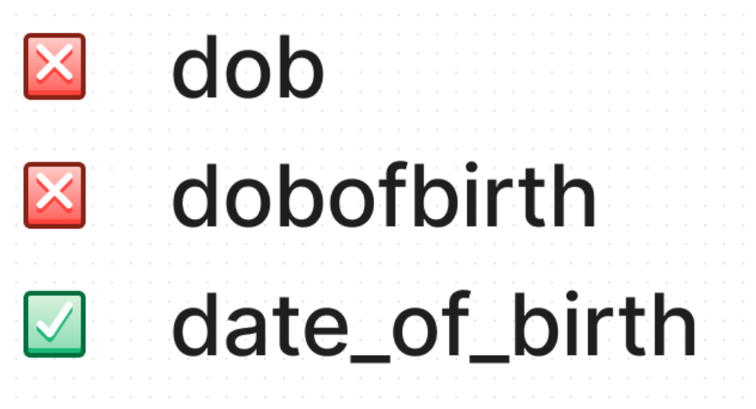
19. Explain how you can optimize the performance of SQL queries on this dataset.
Use Appropriate Naming Conventions -
for example
Use the right data types -
for example
The DATE type is used for values with a date part but no time part.
The DATETIME type is used for values that have both date and time parts in the ‘YYYY-MM-DD hh:mm:ss’ format.
Avoid Nulls as much as possible -
Another design flaw with database schemas is setting NULL as a default even when you don’t mean it. Columns that have NULL data types make it difficult for MYSQL to optimize queries that access them.
If you need to improve disk usage, data access, and query speed a little, you should instead use NOT NULL as default if you are sure that there won’t be any NULL values in a column.
Use Correct Data Types -

Slide 21
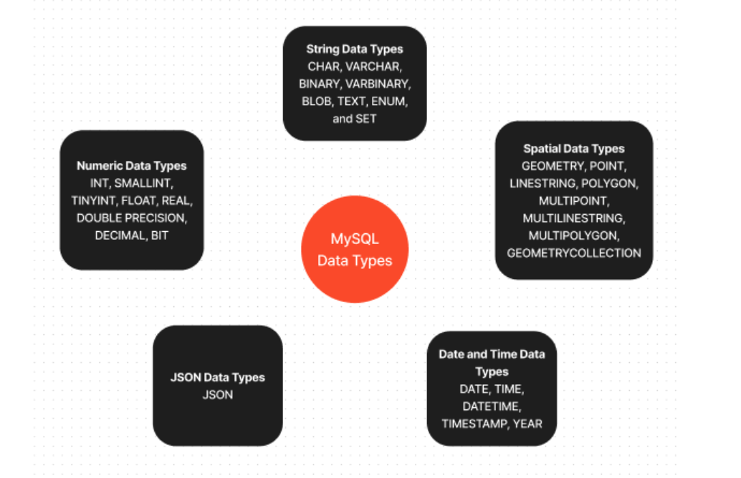
Below are the available datatypes in SQL
Aim for the smallest data type -
for example
When we wish to save strings. Let’s say wehave a column that saves usernames shorter than 30 characters. We can use the VARCHAR(30) to represent data in that column.
For text that may be longer, such as a user’s bio, we can limit the text to, let’s say, 255 characters and use VARCHAR(255).

Slide 22


